Slide 1
War Powers Resolution
§ 1543. Reporting requirement
(a) Written report; time of submission; circumstances necessitating submission; information reported In the absence of a declaration of war, in any case in which United States Armed Forces are introduced—
into hostilities or into situations where imminent involvement in hostilities is clearly indicated by the circumstances; . . .
the President shall submit within 48 hours to the Speaker of the House of Representatives and to the President pro tempore of the Senate a report, in writing, setting forth—
(A) the circumstances necessitating the introduction of United States Armed Forces;
(B) the constitutional and legislative authority under which such introduction took place; and
(C) the estimated scope and duration of the hostilities or involvement.

Slide 2
WPR - 2
§ 1544 (b) Termination of use of United States Armed Forces; exceptions; extension period Within sixty calendar days after a report is submitted or is required to be submitted pursuant to section 1543 (a)(1) of this title, whichever is earlier, the President shall terminate any use of United States Armed Forces with respect to which such report was submitted (or required to be submitted), unless the Congress
(1) has declared war or has enacted a specific authorization for such use of United States Armed Forces,
(2) has extended by law such sixty-day period, or
(3) is physically unable to meet as a result of an armed attack upon the United States. Such sixty-day period shall be extended for not more than an additional thirty days if the President determines and certifies to the Congress in writing that unavoidable military necessity respecting the safety of United States Armed Forces requires the continued use of such armed forces in the course of bringing about a prompt removal of such forces.

Slide 3
WPR-3
§ 1547. Interpretation of joint resolution . . .
(d) Constitutional authorities or existing treaties unaffected; construction against grant of Presidential authority respecting use of United States Armed Forces Nothing in this chapter—
(1) is intended to alter the constitutional authority of the Congress or of the President, or the provisions of existing treaties; or
(2) shall be construed as granting any authority to the President with respect to the introduction of United States Armed Forces into hostilities or into situations wherein involvement in hostilities is clearly indicated by the circumstances which authority he would not have had in the absence of this chapter.

Slide 4
Libya Timeline
Mid-February 2011: popular protests erupt in Libya; Qadhafi answers with violence, opening fire on unarmed crowds.
U.N. Security Council adopted Resolution 1973, demands an immediate ceasefire in Libya and authorizing member states to engage in the use of all necessary measures to protect Libyan civilians.
Two days later, the United States commences military operations to enforce Resolution 1973, launching strikes against Qadhafi’s air defense systems and military airfields in order to lay the groundwork for a no-fly zone over Libya.
March 21: President Obama formally reported these events to congressional leadership “consistent with WPR
April 1: OLC issues opinion memorializing its advice that the President had acted within his constitutional authority to undertake such a military initiative without explicit congressional authorization.
May 20: 60-days run without any further report to Congress or withdrawal

Slide 5
Obama Legal Position
U.S. military operations are distinct from the kind of “hostilities” contemplated by the Resolution’s 60 day termination provision. U.S. forces are playing a constrained and supporting role in a multinational coalition, whose operations are both legitimated by and limited to the terms of a United Nations Security Council Resolution that authorizes the use of force solely to protect civilians and civilian populated areas under attack or threat of attack and to enforce a no-fly zone and an arms embargo. U.S. operations do not involve sustained fighting or active exchanges of fire with hostile forces, nor do they involve the presence of U.S. ground troops, U.S. casualties or a serious threat thereof, or any significant chance of escalation into a conflict characterized by those factors.

Slide 6
From H. Rept. 93-287, War Powers Resolution of 1973, 93d Cong., 1st Sess. (1973).
The Cambodian incursion of 1970 provided the initial impetus for a number of bills and resolutions on the war powers. Many members of Congress, including those who supported the action, were disturbed by the lack of prior consultation with Congress and the near crisis in relations between the executive and legislative branches, which the incident occasioned. . . .The term “war powers” may be taken to mean the authority inherent in national sovereignties to declare, conduct, and concluded armed hostilities with other states. (pp. 19-20)

Slide 7
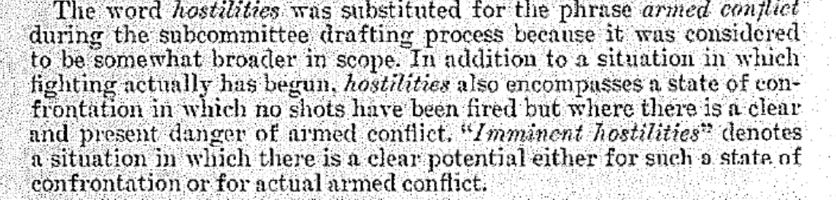
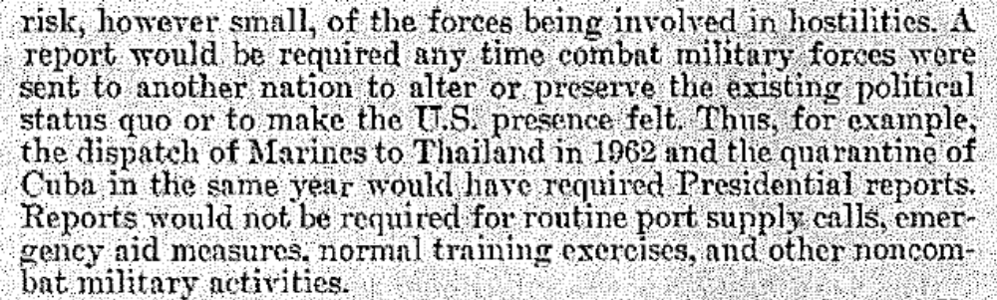
From H. Rept. 93-287, War Powers Resolution of 1973, 93d Cong., 1st Sess. (1973).

